Slide 1
Employee Data Analysis using Excel
STUDENT NAME: NISHA M
REGISTER NO: 312203148
DEPARTMENT: B.COM (GENERAL)
COLLEGE: ASAN MEMORIAL COLLEGE OF ARTS AND SCIENCE.

Slide 2
PROJECT TITLE
Employee Performance Analysis using Excel

Slide 3


AGENDA
Problem Statement
Project Overview
End Users
Our Solution and Proposition
Dataset Description
Modelling Approach
Results and Discussion
Conclusion
3/21/2024 Annual Review

Slide 4

PROBLEM STATEMENT
Employee performance evaluations are conducted to:
Measure job performance.
Provide feedback and development
Align goals with company objectives
Inform compensation decisions.
Motivate employees.
Offers legal protection.
Aid in succession planning.
Identify training.

Slide 5

PROJECT OVERVIEW
Employee performance refers to how well an employee fullfill their job duites and contributes to organisational goals. It involves measuring productivity, quality of work, efficiency, and overall contribution. Evaluation employees performance helps identify strengths and areas for improvement, guides development and ensures alignment with company objectives. Effectives performances management leads to motivated employees, better organisational outcomes, and a clear path for growth and development.

Slide 6
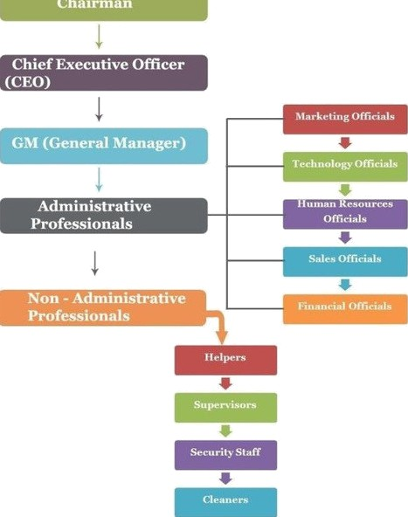

WHO ARE THE END USERS?

Slide 7

OUR SOLUTION AND ITS VALUE PROPOSITION
Conditional formatting using
IFS(G10>1,”Applicable”,G10>=1”Not Applicable
“,G10=1,”Perfect”)
Usage of pivot table, pie chart and bar graph

Slide 8
Dataset Description
Downloaded employees data set using- Kaggle
Features used :
Emp ID
Name
Gender
Department
Salary
Start Date
FTE
Employee type
Work location
Eligibility

Slide 9

THE "WOW" IN OUR SOLUTION
IFS(G10>1,”Applicable” , G10>=1,”Not applicable”,G10=1,”perfect”)
Pivot table, pie chart and paragraph
Highlighting the features
Interpreting the salary of each individuals.
3/21/2024 Annual Review
9

Slide 10
MODELLING
Downloaded employees data sheets from Kaggle
Selected 20 datasets in the downloaded data sheets and created a new data sheets
Highlighted the features used in the data sheet
Select the employee performance and done the eligibility status
Create the pivot column and created pie chart and bar graph
Made analysis using the bar graph
10

Slide 11
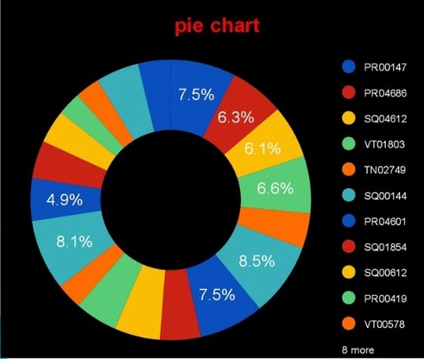
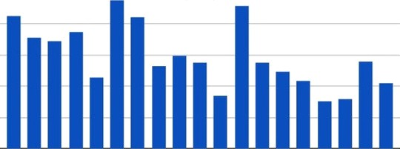
RESULTS
11

Slide 12
conclusion
In conclusion, effective employee performance management is essential for both individual and organizational success. It ensures that employees are meeting expectations, contributing to the company’s goals and continuously developing skills their regular performance evaluations not only drive motivation and productivity but also enable informed decisions regarding promotions, compensation, and career development ultimately, a strong focus on employee performance leads to a more engaged, efficient, and successful workforce

